Slide 1
Design Description presentation
18/10/2018
Group 1

Slide 2
Summary
Use case model
User interfaces
Architecture: components overview
Persistent data management
Dynamic structure - interaction between applications and components
Detailed component design - static structure and dynamic behavior
Implementation considerations and experiences so far

Slide 3
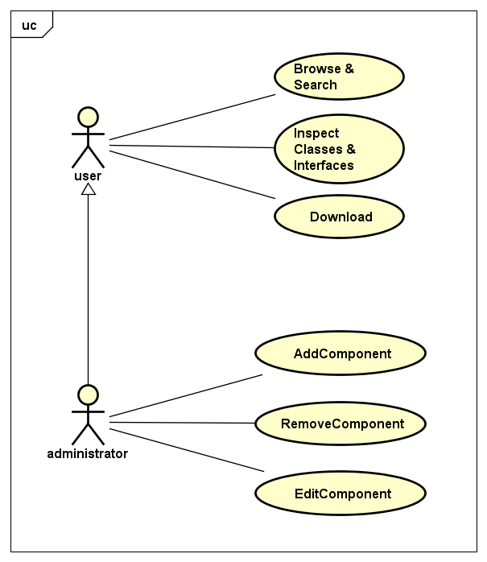
Use Case Model
«The types of User»
Normal user:
Just a visitor of the repo. Can Browse & Search, Inspect and Download Components.
Administrator:
Can perform the same operations of the previous one but can also perform particular operations on the components

Slide 4
User interfaces
User UI
Adminisatror UI
On a web page
ASP (.NET)
Browse & Search
Inspect components
Download components
Desktop Application (.NET)
Add, Remove, Edit components
Got the user's actions.

Slide 5
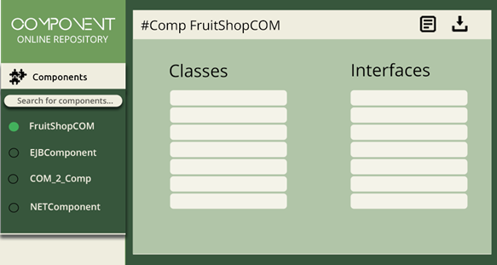
User UI

Slide 6
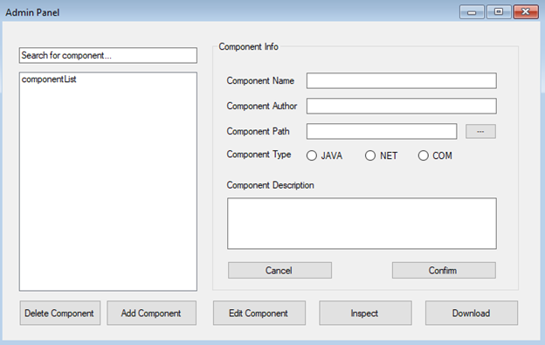
Administrator UI

Slide 7
Architecture: components overview

Slide 8
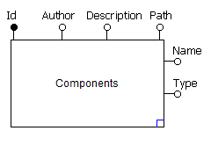
Persistent Data Management
There is no login => no users data management
Only information concerning the components

Slide 9
Detailed component design - static structure and dynamic behavior
Web application
Admin Application
Main functionality - controllers
Database Handler

Slide 10
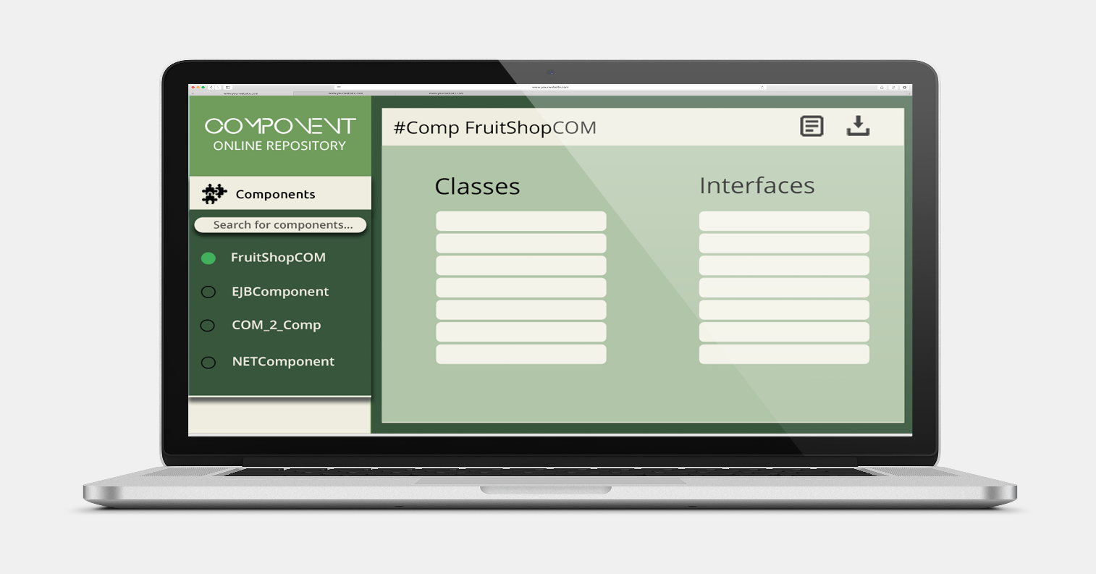
Web Application
Represents a VIEW (GUI) for web based solution
Static structure / Dynamic structure
Notes:
When it comes to static structure or basically what is provided to the user before the user interaction.

Slide 11
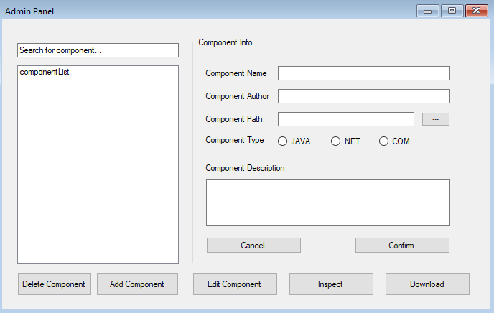
Admin Application
Represents a VIEW (GUI) for standalone windows application
Static structure / Dynamic structure

Slide 12
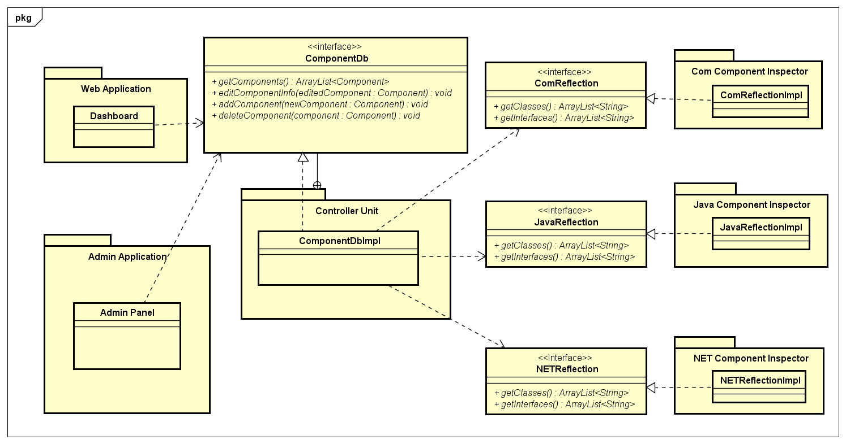
Main functionality- controllers
Static structure – class diagram

Slide 13
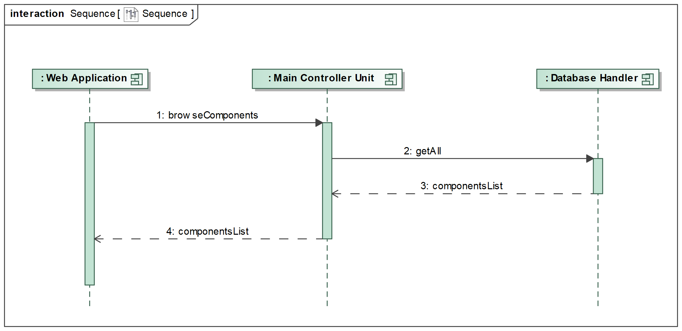
Main functionality- controllers
Dynamic Structure – sequence diagram
Browse components scenario

Slide 14
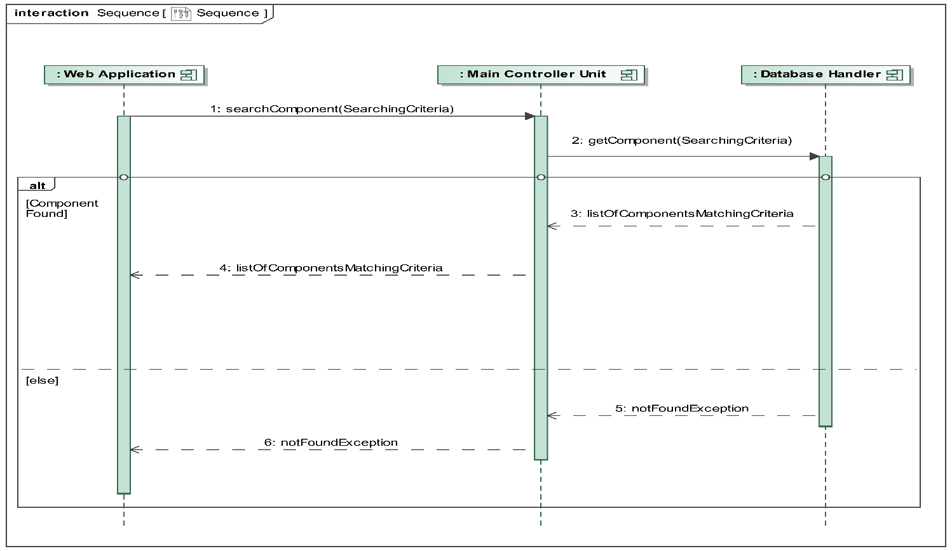
Main functionality- controllers
Dynamic Structure – sequence diagram
Search component scenario

Slide 15
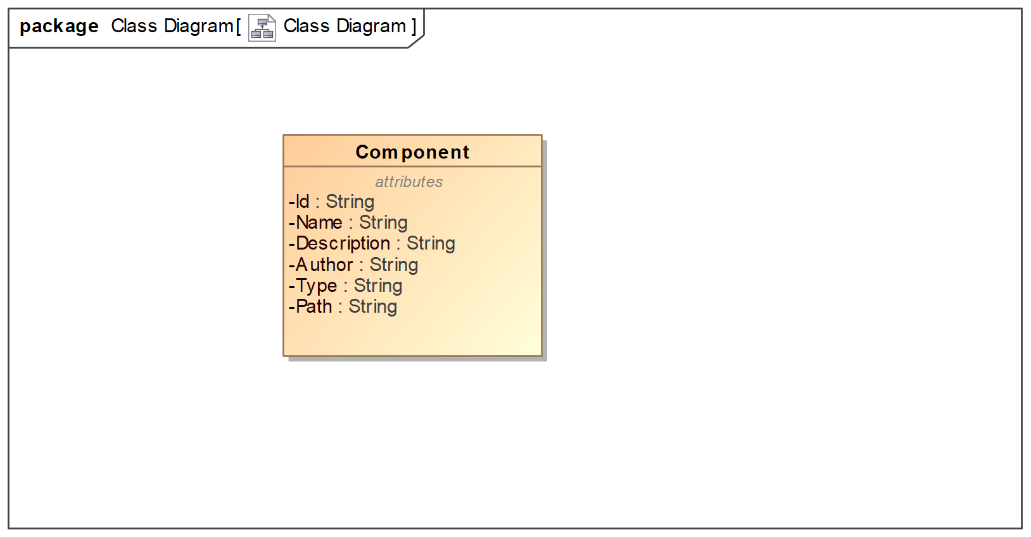
Database Handler
Enables database access
Accomplished by using MySQL Data Connector

Slide 16
Dynamic structure - interaction between applications and components
Web application (visitor - user)
Download action
Components inspection
Search and find
Windows form application (administrator)
Add components
Search and find
Edit components
Inspecting components
Deleting components
Download action

Slide 17
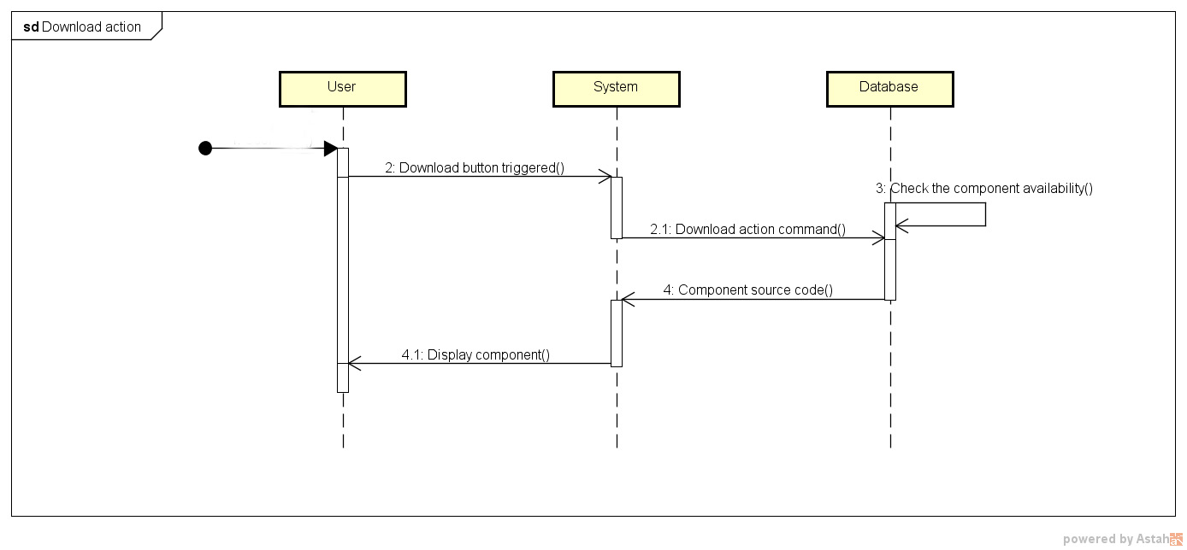
Download action Successful case

Slide 18
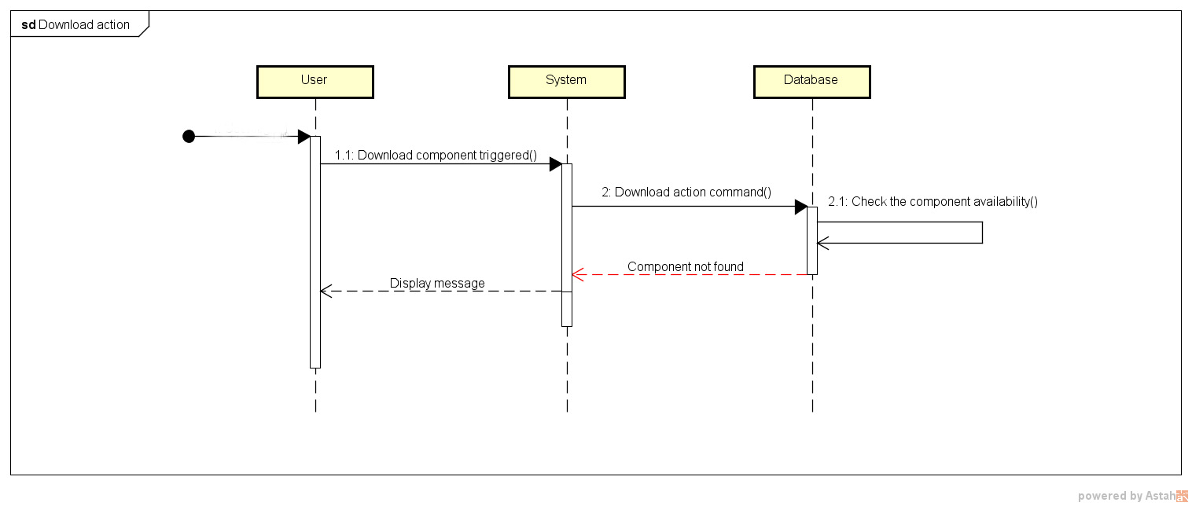
Download action Alternative case

Slide 19
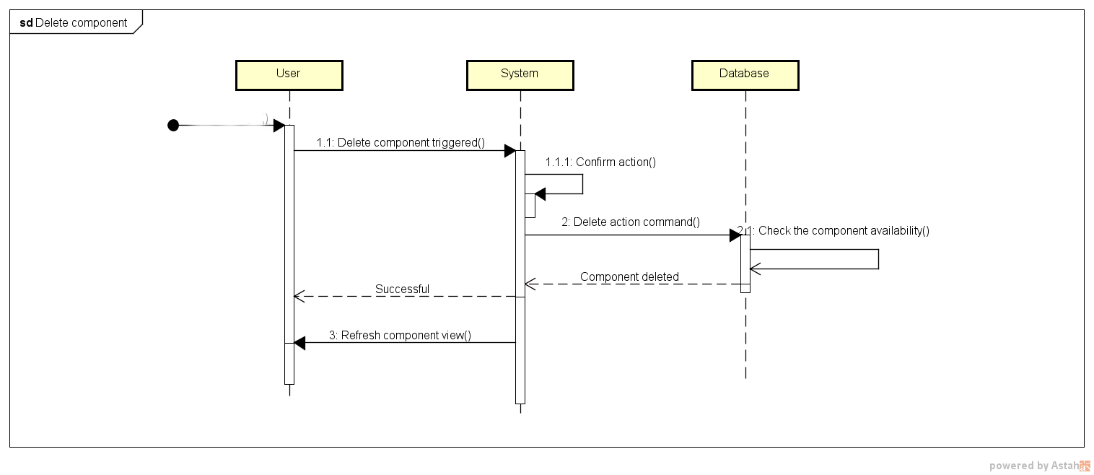
Delete action successful case

Slide 20
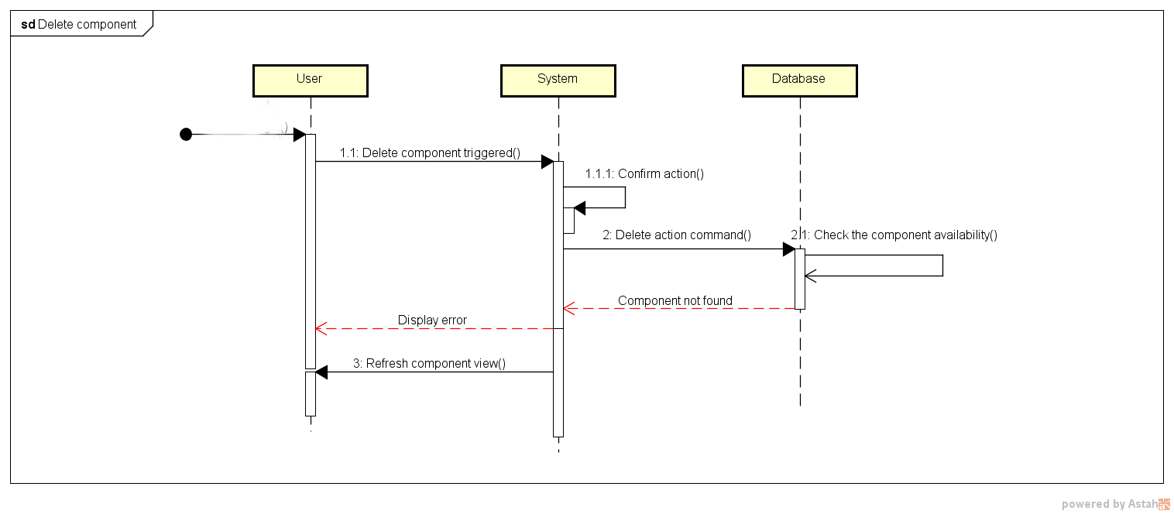
Delete action alternative case

Slide 21
Implementations considerations
The inspection of the components is implemented in different languages:
The COM component is implemented in C++
The Java component is implemented in Java
The .NET component is implemented in C#.
We have not done more than implementing some UI and connected a database to it.

Slide 22

Questions

